Slide 1

Thymio discovering USI!
Arslan Ali – Group W
Dr Giusti A.
Dr Cereda E.
Dr Mantegazza D.

Slide 2
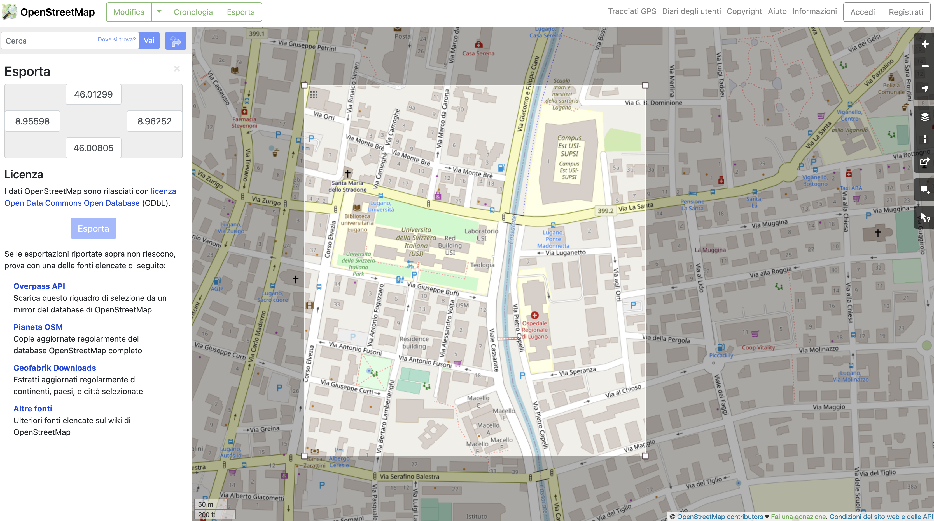

Slide 3
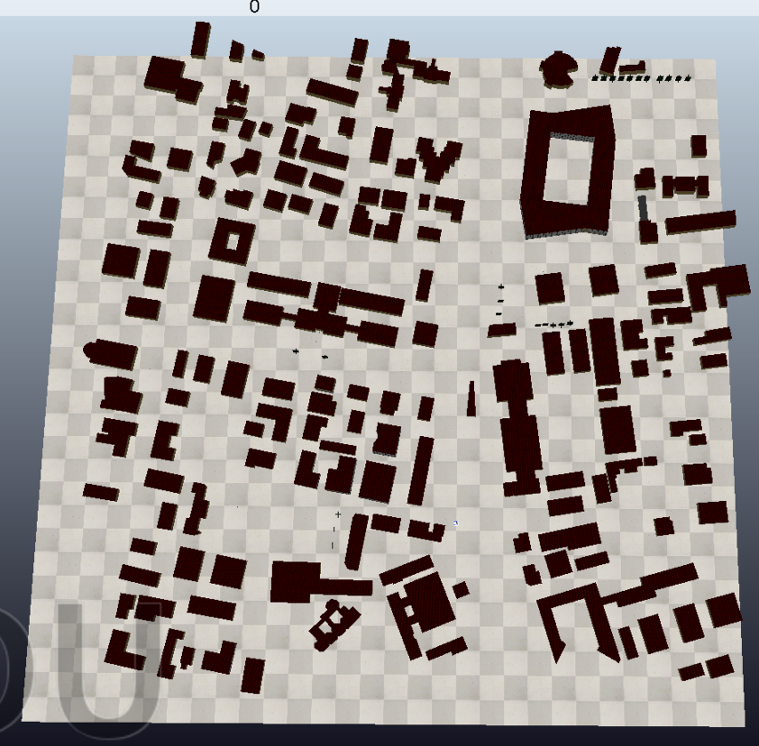

Slide 4
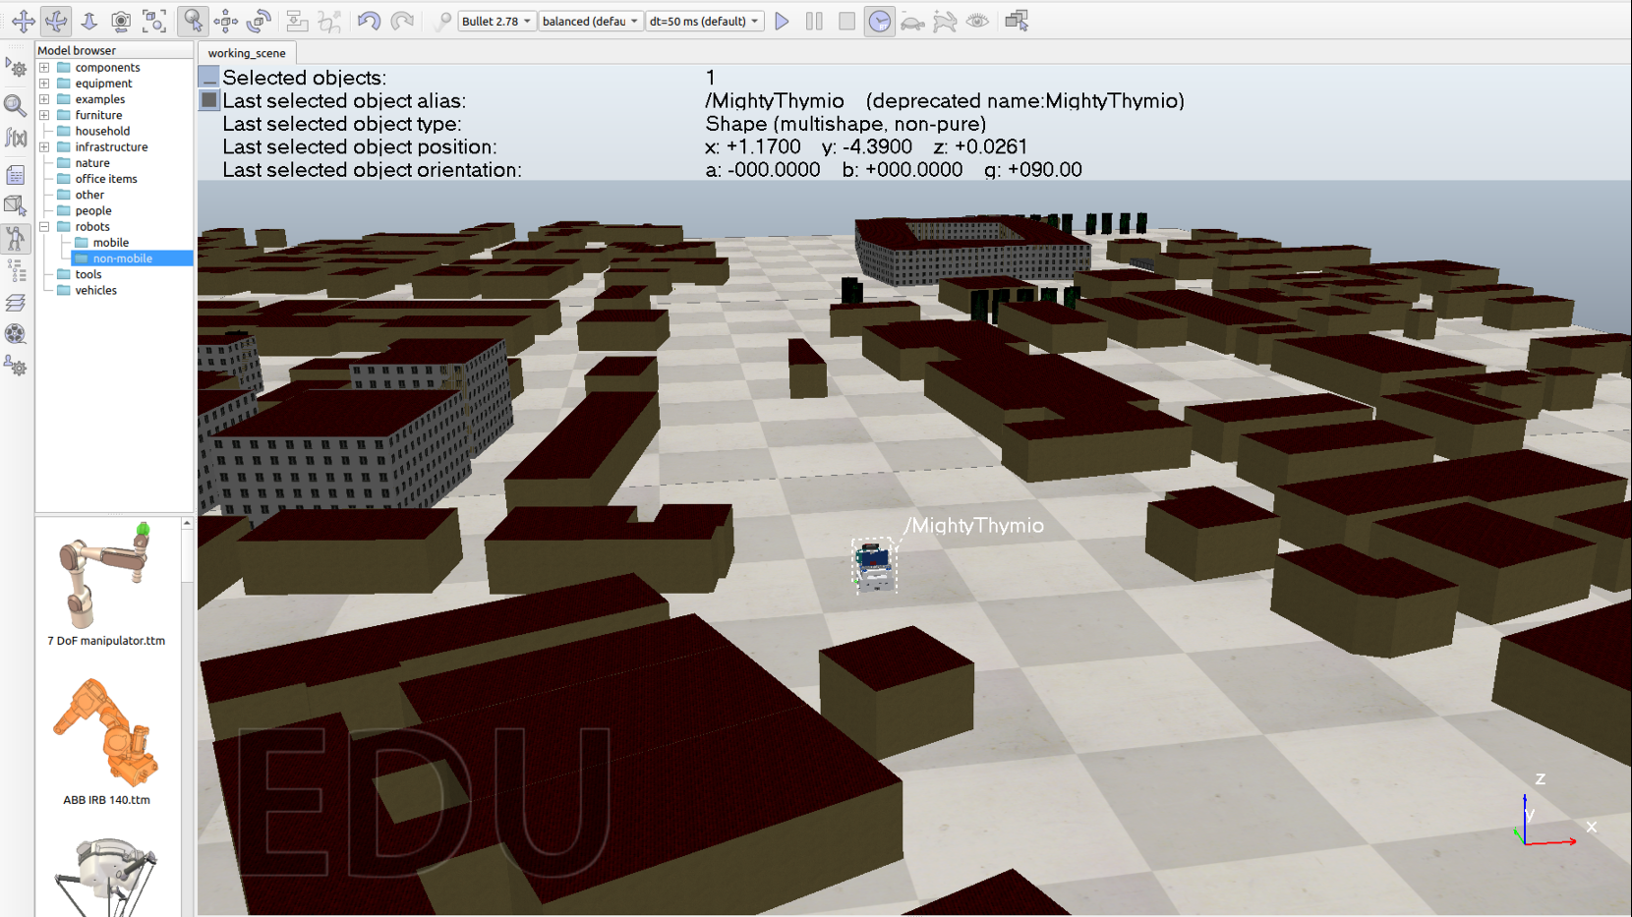

Slide 5
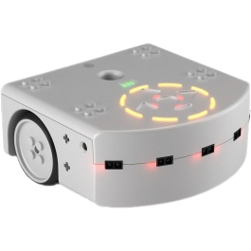


Proximity sensors
Camera

Slide 6
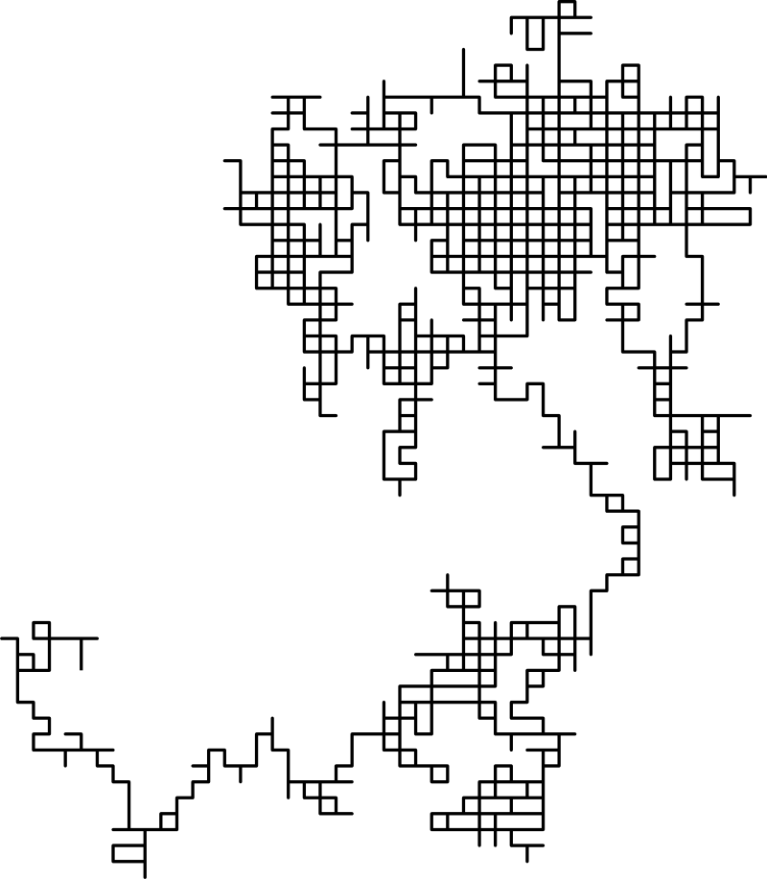
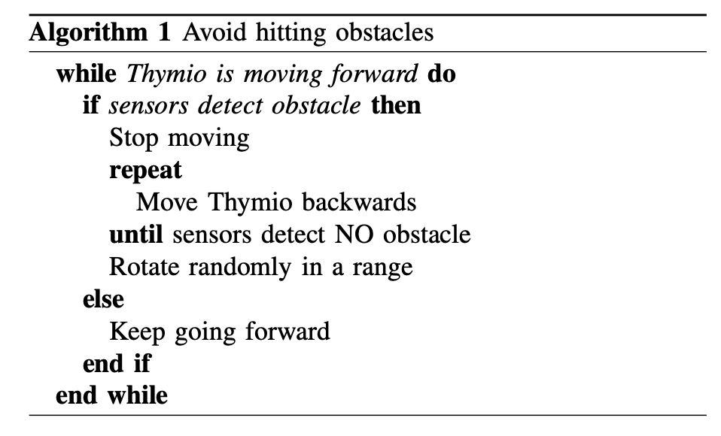
Path Planning

Slide 7
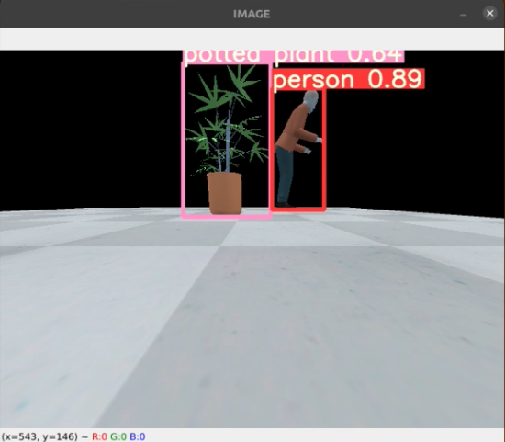


Real Time Object Detection

Slide 8
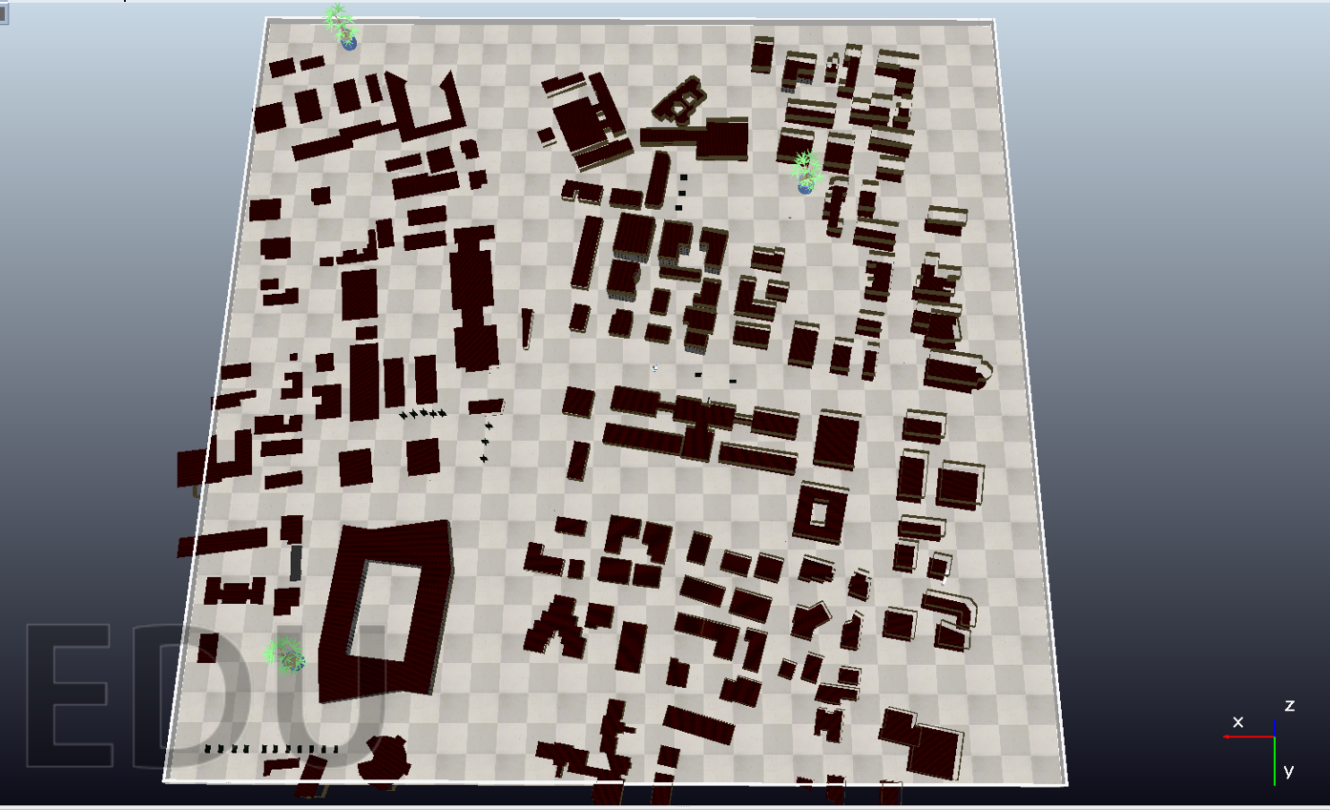

Slide 9
Thank You For Your Attention

